Slide 1
Blocks World 4 Team 3
Why we hate it.

Slide 2
Scenario Editor
Ease of use
Configure the connection parameters
Add, modify and delete bots & e-partners
Saving and loading scenario’s
Export to MAS2G project.
Fully integrated with the BW4T server and client.
Notes:
Just the main features of the scenario editor. Don’t go too deep into the botstore functionality!
Ramble about the ease of use, especially how we used the personas and in the end did used tests based on these personas. But keep it short.
Mention the sending of the saved configuration file to the server, the exporting to mas, and the ability to reload a scenario.
TIME: ~ 2 mins.

Slide 3
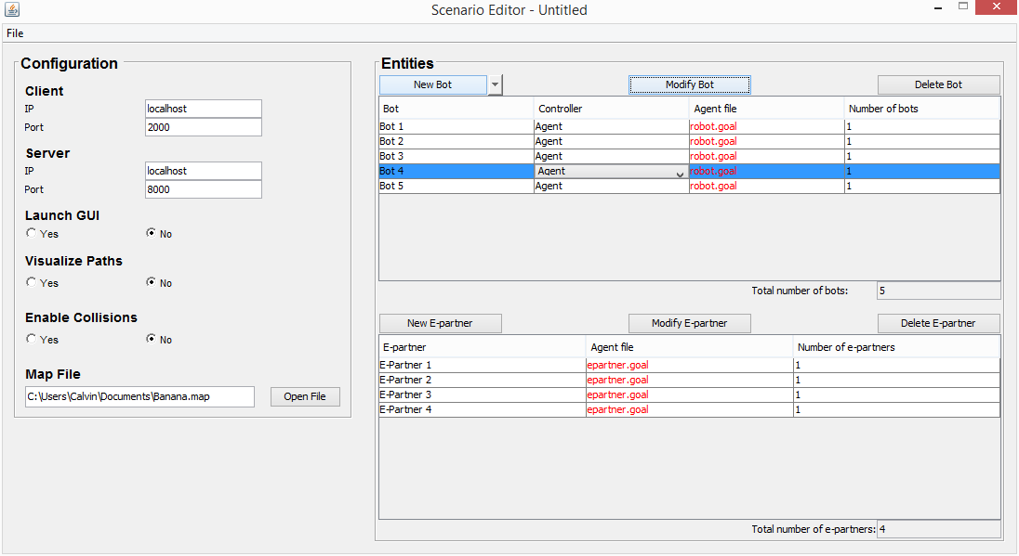
Scenario Editor
Notes:
START TALKING ABOUT THE BOTS FIRST, then we go to the bot store. Don’t mention the other parts!
Time: ~30 seconds.

Slide 4
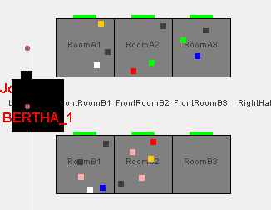
Bot Editor
Allows for the customization of the bots
Handicaps:
  Size
  Speed
  Gripper
  Battery capacity
  Colour blindness
Notes:
BOTSTORE:
Quicky go through the list, clicking as you go, or else I made the animation for nothing.
Suppose you are a bunch of researches in that specific domain. I mean – what would be the first thing you’d want to have made available for use? Wouldn’t it be nice to be able to customize your robots a little, instead of having this boring plain robot that runs around like an idiot?
Well, congratulations! We have designed a way to add different capabilities to our little robots, capabilities that enhance the robots’ abilities, as well as improve the physical realism of the system. There it is: the decorator pattern. I’d like to assume I do not need to explain what this design pattern entails…
Hypothetically, making robots better is always fun, but as the bunch of researchers that you are, you want to have realistic results from your observations. Let’s say you want to simulate a failing robot, no need to worry! We have added a couple of “handicaps”, if we can put it that way, such as too big, too small, too fast, too slow, no gripper (basically too retarded to pick up blocks), etc…
Ok, we have spoken of robots and making them better (or worse).
Go back to the scenario editor overview.
TIME: 2 mins max
But that ain’t all! (YEE-HAW) We wanted more than this boring map we see all the time. What if you were able to modify this map, and modify it entirely? There it is: the Environment Store.

Slide 5
Scenario Editor
Notes:
DÉJÀ VU? That’s true! But it’s epartner time now. Not sure what to say? Just vaguely explain the idea.
Time: ~30 seconds.

Slide 6
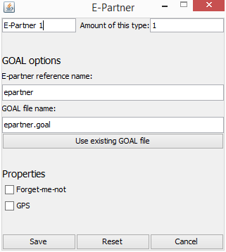
Epartners
Lame pickups
I really don’t know what else we could add here.
Notes:
Epartners…
Time: 1.5 min

Slide 7
Scenario Editor
Notes:
Quickly mention the map and then go to environment store
But that ain’t all! (YEE-HAW) We wanted more than this boring map we see all the time. What if you were able to modify this map, and modify it entirely? There it is: the Environment Store.
Time: ~30 seconds.

Slide 8

Environment Store

